Slide 1
Master of IT in Business ISSS610 APPLIED MACHINE LEARNING
Toxic Comment Classification
Project Group 5:
Ayushi JAISWAL
Milouni DESAI
SOH Hui Shan
TEO Yaling

Slide 2
Agenda
Introduction
- Problem Statement
- Dataset
- EDA
- Overall Approach
Initial Approach
- Challenges
Revised Approach
Flow Chart
Feature Engineering
Model Results & Feature Importance
Examples

Slide 3


Problem Statement
Background
Online discussion is an integral aspect of social media platforms but it has become an avenue for abuse and harassment.
Hi! I am back again! Last warning! Stop undoing my edits or die!
6 Classes
Objective
Build a multi-label classification model to detect different types of toxicity for each comment.
Toxic
Obscene
Severe Toxic
Insult
Threat
Identity-Hate
Notes:
Online discussion is an integral aspect of social media platforms but it has become an avenue for abuse and harassment where people leave comments that are rude, disrespectful and even toxic. The objective of our project is to build a multi-label classification model to detect different types of toxicity for each comment.

Slide 4
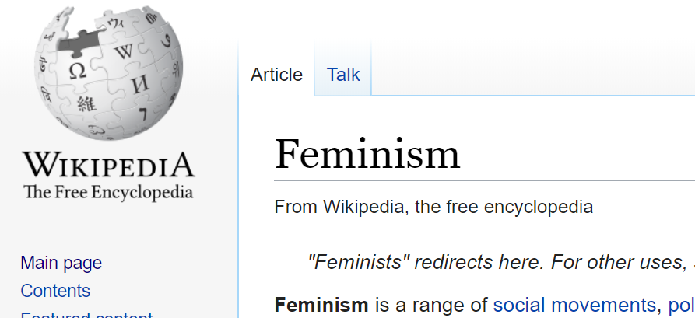
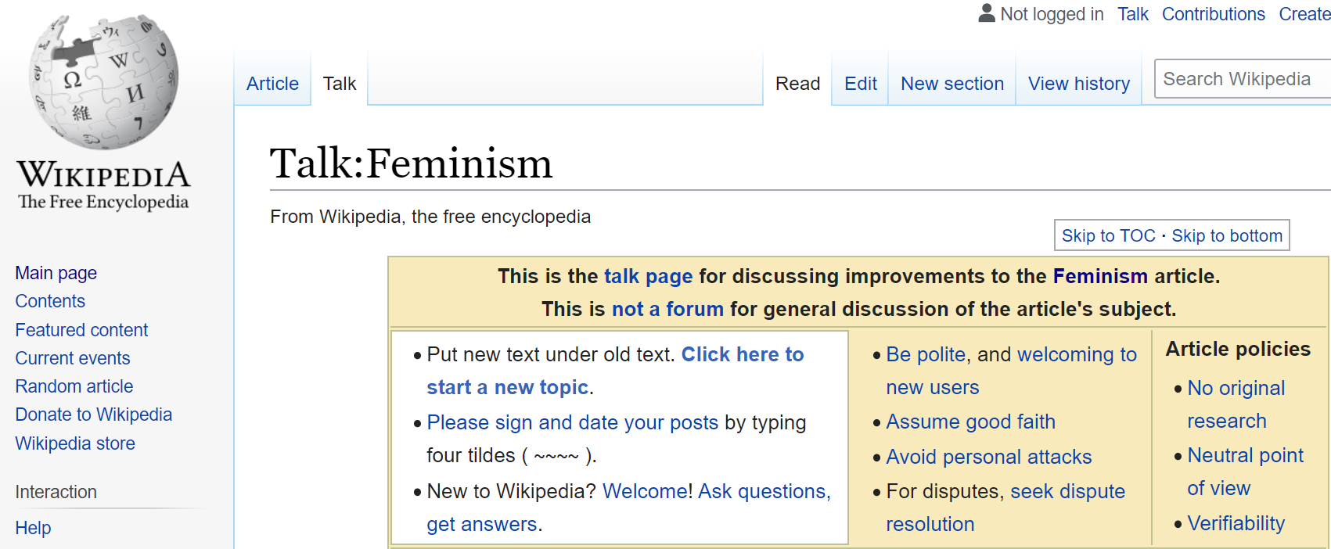
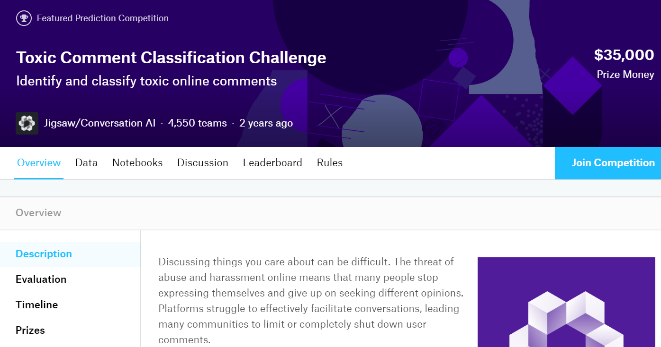
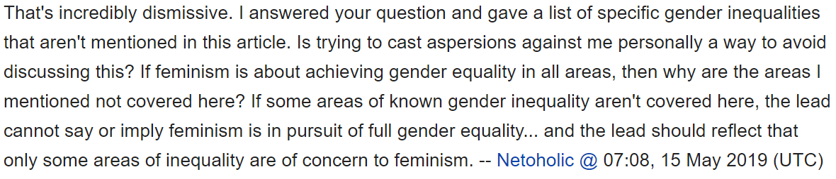
Dataset
Kaggle Competition Dataset
150k comments from Wikipedia Talk pages
6 Classes of Toxicity
Toxic
Severe toxic
Obscene
Threat
Insult
Identity hate
Dataset can be downloaded from: https://www.kaggle.com/c/jigsaw-toxic-comment-classification-challenge/overview

Slide 5
Dataset
Sample Records
6 classes
id | comment_text | toxic | severe _toxic | obscene | threat | insult | identity _hate
1 | Hi! I am back again! Last warning! Stop undoing my edits or die! | 1 | 0 | 0 | 1 | 0 | 0
2 | Gays are disgusting. It's just my opinion but gays are disgusting. | 1 | 0 | 0 | 0 | 1 | 1
3 | IM GOING TO KILL YOU ALL!! I'm serious, you are all mean nasty idiots who deserve to die and I'm going to throw every single one of you in a shredder!!!!!!!!! | 1 | 1 | 0 | 1 | 1 | 0
Notes:
A comment can belong to multiple classes

Slide 6
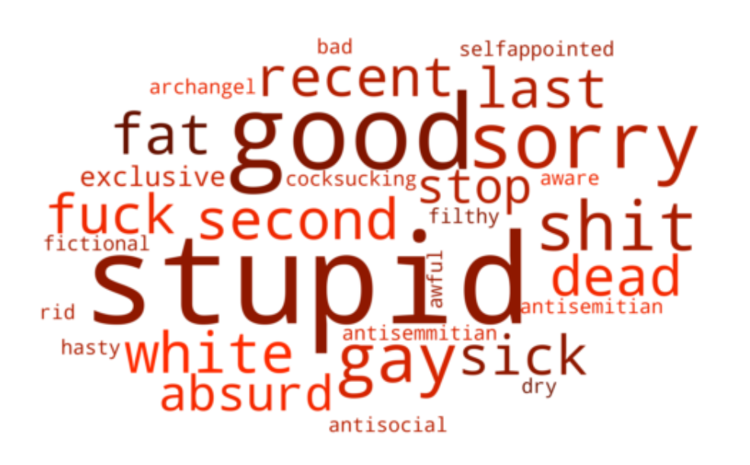
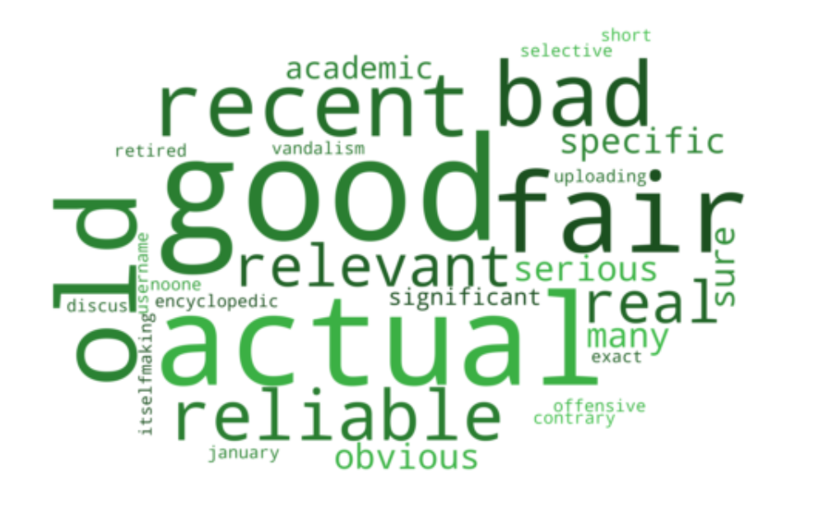
EDA
Word cloud for toxic comments
Word cloud for clean comments
About 90% of comments are clean.
Word clouds for all toxic labels look very similar to each other.

Slide 7
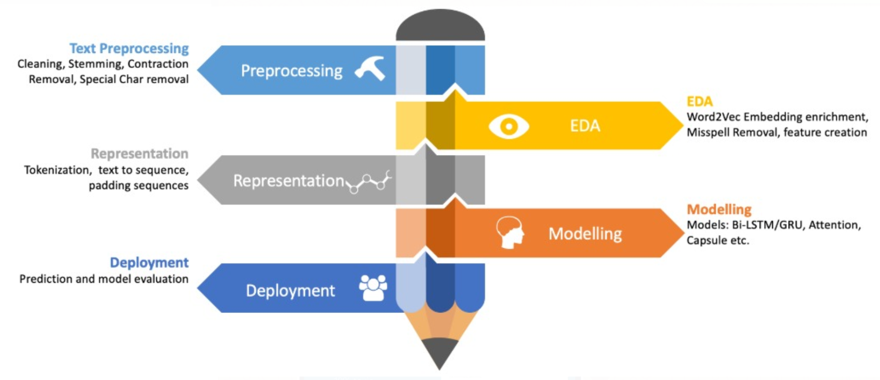
Approach
Text Preprocessing
Remove punctuation, Lemmatization,
Remove stopwords
Preprocessing
EDA
Data Visualization of Distributions and Word Clouds
EDA
Feature Engineering
Bag of Words, TF-IDF, Word Embeddings
Feature
Engineering
Modelling
Naïve Bayes,
Convolutional Neural Networks (CNN),
Long Short-Term Memory Networks (LSTM)
Modelling
Validation & Evaluation
Precision, Recall,
F1-score, Accuracy
Validation &
Evaluation

Slide 8
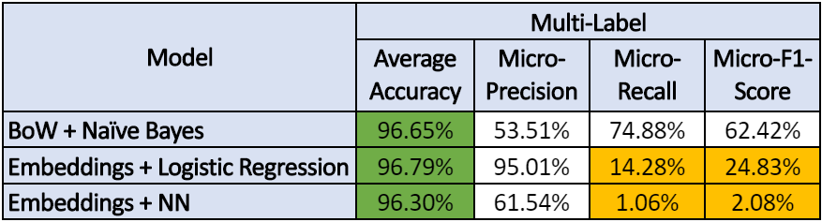
Initial Approach: Results
Results of 6-label Classification*
High Ave. Accuracy 96%
but
very low Micro-Recall and Micro-F1 score
Why???
Let’s look at Confusion Matrix…
avg_accuracy = sum(accuracy) / no_of_labels
micro_precision = sum(TP) / (sum(TP) + sum(FP))
micro_recall = sum(TP) / (sum(TP) + sum(FN))
micro_f1_score = (2 * micro_precision * micro_recall) / (micro_precision + micro_recall)
* with subset of ~50k records
Notes:
Our initial approach is to run a model that classify the records into 6 labels. We have run 3 different models and each of them has a high average accuracy of 96%. However, the micro-recall and micro-F1 score is very low for embeddings + LR and NN model. To find out the reason, we look at the confusion matrix.

Slide 9
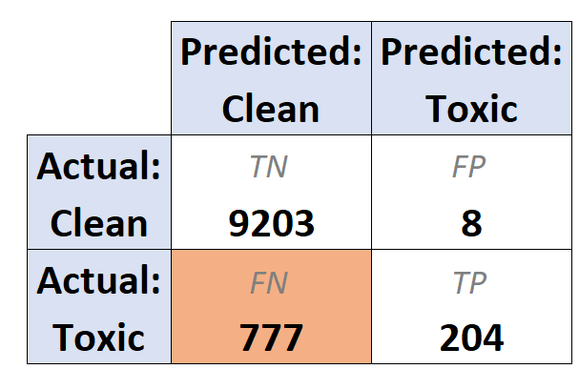
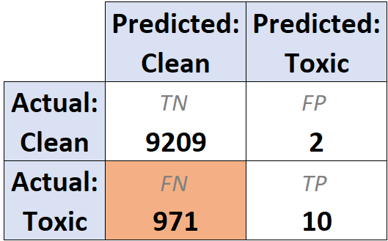

Initial Approach: Challenges
High Accuracy but High False Negatives
Embeddings + Logistic Regression
Embeddings + Neural Network
High FN is an issue, we want it to be low
High accuracy is driven by imbalance data (90% clean)
How do we deal with these issues?
Notes:
From the confusion matrix, we see that False Negatives are very high which means that the models are predicting the toxic comments as clean. From the business perspective, if we want to use this model to flag out and remove toxic comments from a discussion forum, the model will not be able to because it will predict toxic comments as clean. Therefore, we know that the high accuracy of our model is driven by the imbalance data where 90% of our comments are clean.

Slide 10
Revised Approach
Notes:
So like we saw, though the accuracy was good, confusion matrix gave us a clearer picture of what's actually happening.
So we looked at the problem in a slightly different way, and went ahead with a different approach.

Slide 11

Revised Approach
1. Down-sampling 60:40 to deal with imbalanced data
Notes:
First, we realized that since the data was highly imbalanced (90% clean comments), the models were predicting most of the comments as clean. So, we down-sampled the data to a ratio for ~ 60:40 in favor of clean.

Slide 12
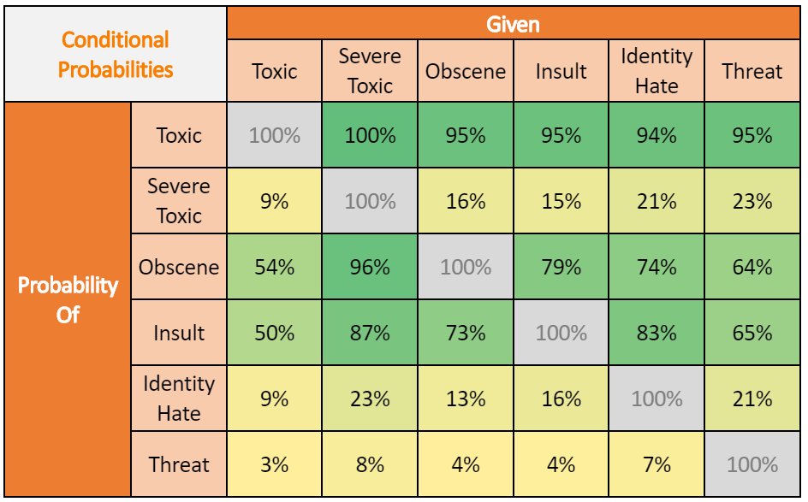
Revised Approach
2. Conditional Probabilities of Each Class
P(Toxic | Severe Toxic) | = | 100%
P(Toxic | Obscene) | = | 95%
P(Toxic | Insult) | = | 95%
P(Toxic | Identity Hate) | = | 94%
P(Toxic | Threat) | = | 95%
Probability Matrix
The other 5 labels are highly dependent on Toxic.
Therefore, this leads us to use a
2-level classification approach.
Notes:
Next important thing Prof suggested to look at, was the conditional probabilities for all the labels. This is to understand how related are the occurrences of the labels.
So what we observed here was that the occurrence of all the labels was highly dependent on 'toxic' label. For example, if we look at the first one, P(toxic | severe toxic), it's 100%. This means that whichever comments were labeled as severe toxic were also labeled as toxic. Similarly, 95% of the comments labeled as Obscene were also labeled Toxic. Same for the other three labels.
All the probabilities are >= 94%.
This kind of observation led us to have a 2-level classification approach.

Slide 13


Revised Approach: Flow Chart
2-level Classification Approach
Down Sampling
Feature Engineering
1st
Level
Binary Classifier
Toxic
Clean
Pass only comments that are predicted as toxic
Multi-label Classifier
2nd
Level
Severe Toxic
Threat
Obscene
Insult
Identity-Hate
Notes:
So, as mentioned earlier, we did down-sampling and then some feature engineering, which will be discussed later in detail.
Then, we have a binary classifier to predict just one label - 'toxic'. Once this is done, we pass only the comments which were predicted toxic, to the multilabel classifier for predicting the other 5 labels.

Slide 14

Revised Approach: Flow Chart
2-level Classification Approach
Down Sampling
Feature Engineering
Binary Classifier
Accuracy
Precision
Recall
F1-score
1st
Level
Toxic
Clean
Overall
Accuracy
Multi-label Classifier
Average Accuracy
Micro - Precision
Micro - Recall
Micro - F1-score
2nd
Level
Severe Toxic
Threat
Obscene
Insult
Identity-Hate
Notes:
As for the evaluation metrics, we are calculating accuracy, precision, recall and F1 score.
For multilabel classifier, the averaging is micro since there is still imbalance for some of the labels, so micro averaging will account for it.

Slide 15
Revised Approach:
Feature Engineering

Slide 16
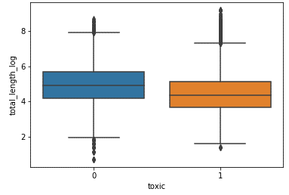
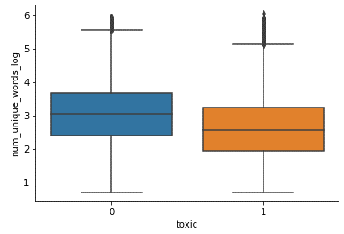
Revised Approach: Feature Engineering
Word-level Features
Pre-processing Steps:
Retained case structure (lower case, upper case)
Removed URLs, HTML tags, stop words
Removed punctuation, except for “!”
Lemmatization
Vectorization Methods:
Bag of Words (BoW)
Term Frequency Inverse Document Frequency (TF-IDF)
Binary Representation of each Word
Word Embeddings:
Pre-trained GloVe word embeddings
Comment-level Features
Word count
Character count
Word density (Word count / Character count)
Total length
Capitals
Proportion of capitals
Number of exclamation marks
Number of unique words
Proportion of unique words
Total length
Number of unique words
Notes:
Bag of Words (BoW): Top N words with highest frequency for each label
Term Frequency Inverse Document Frequency (TF-IDF): Frequency of each word within each comment with a penalty applied to common words across all comments
Binary Representation of each Word: Assign 1 or 0 to each word

Slide 17
Revised Approach:
Model Results

Slide 18
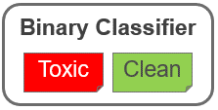
Revised Approach: Model Results
1st level Binary Classification
Best Performing Model: Embeddings + CNN
Model Selected: TF-IDF + SVM
Reasons:
Less complex model at a cost of < 0.5% reduction in f1-score.
Simpler features (TF-IDF vs. Embeddings)
Greater interpretability of model’s results as feature importance can easily be extracted with SVM unlike NN/CNN
Initial Approach
Embeddings + Logistic Regression
Final Approach
TF-IDF + SVM
Comparing Between Initial and Final Approach:
Reduction in False Negatives (predicted as Clean when actually Toxic)
Improvement in True Positives (predicted as Toxic when actually Toxic)
Notes:
'weighted’: Calculate metrics for each label, and find their average weighted by support (the number of true instances for each label). This alters ‘macro’ to account for label imbalance; it can result in an F-score that is not between precision and recall.

Slide 19
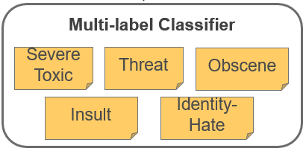
Revised Approach: Model Results
2nd level Multi-label Classification
Best Performing Model: Embeddings + CNN
Model Selected: Binary + Logistic Regression
Reasons:
Less complex model at a cost of < 1% reduction in micro f1-score
Simpler features (TF-IDF vs. Embeddings)
Greater interpretability of model’s results as feature importance can easily be extracted with logistic regression.

Slide 20
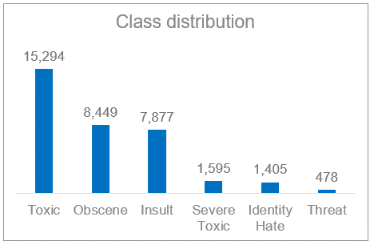
Revised Approach: Model Results
2nd level Multi-label Classification
Comments:
Multi-label classification produced results with low precision and recall due to certain labels having significantly less records.
For these 3 labels, False Negatives are high, ie. predicted as Clean when actually are Severe Toxic / Threat / Identity Hate.

Slide 21
Revised Approach: Final Model
Selection of Final Model:
1st – level: TF-IDF + SVM
2nd – level: Binary + Logistic Regression
Overall Accuracy on Test Results:

Slide 22

Revised Approach:
Feature Importance

Slide 23
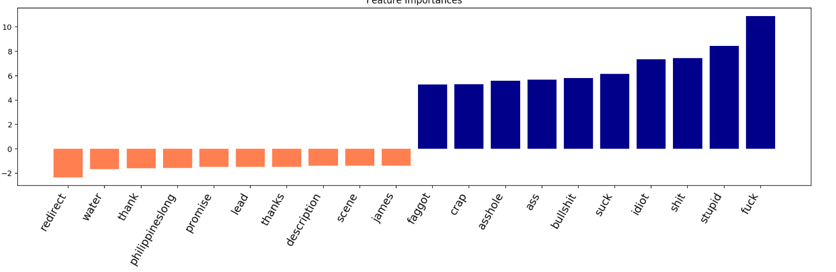
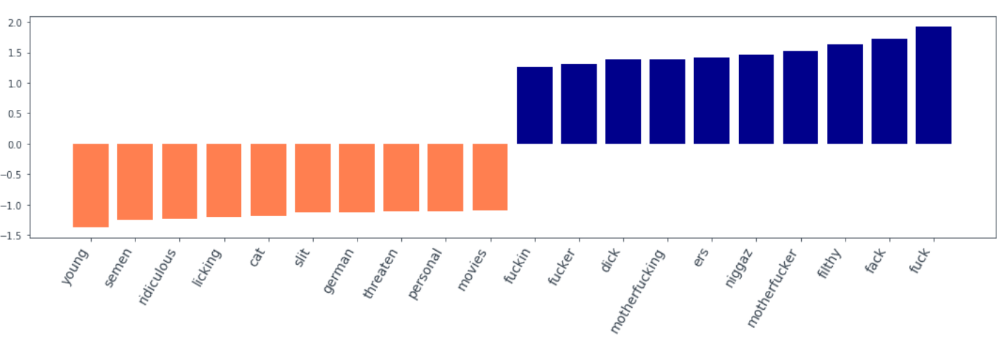
Feature Importance
Label: Toxic
Label: Severe toxic
Notes:
A comment can belong to multiple classes
Nigga and different spellings of nigga
Homosexuals

Slide 24
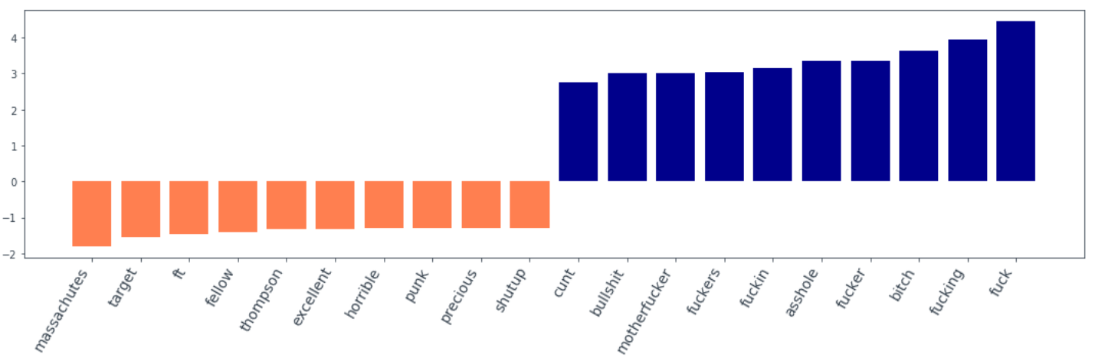
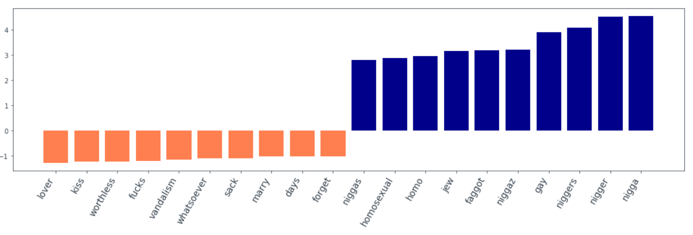
Feature Importance
Label: Obscene
Label: Identity Hate
Notes:
A comment can belong to multiple classes
Nigga and different spellings of nigga
Homosexuals

Slide 25
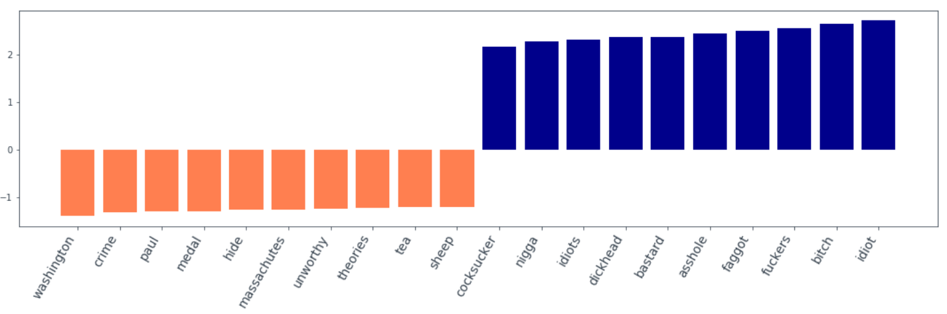
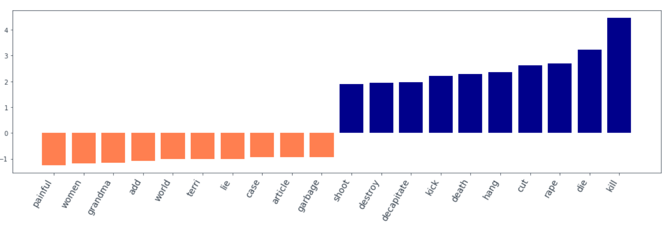
Feature Importance
Label: Insult
Label: Threat
Notes:
A comment can belong to multiple classes
Nigga and different spellings of nigga
Homosexuals

Slide 26
Revised Approach: Examples
Comment | True Labels | Predicted Labels
Hello, you disgusting transsexual. You are a grotesque blight upon the earth. Please kill yourself. | Toxic, Obscene, Threat, Identity Hate, Insult | Toxic, Obscene, Threat, Identity Hate, Insult
Wtf, Why You deleting Maashel? Bad things will happen to you now. | Toxic, Threat | Toxic
am going to shoot you in the head and laugh as your brains splatter onto the ground. | Toxic, Severe Toxic, Threat | Toxic, Threat
Notes:
A comment can belong to multiple classes

Slide 27
Thank You

